Slide 1

Deep Learning Recommender Systems
Author: Hussain Abbas, MSc
© 2021 Stats AI LLC
All Rights Reserved

Slide 2
Wide & Deep Learning
2016

Slide 3
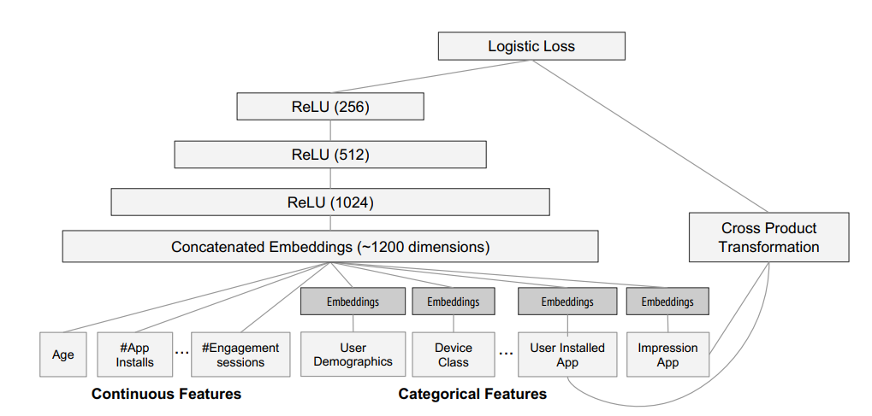
Wide & Deep Learning for Google Play Store Recs
https://dl.acm.org/doi/pdf/10.1145/2988450.2988454

Slide 4
Example
Query:
Suppose we have a food delivery app that allows a user to state what kind of food that they are craving
Their statement is the “query”
Example: “I want seafood”
Item:
The app predicts the dish the user will like best and delivers it to the user
The dish is the “item”
Example: “Shrimp fried rice”
Online Evaluation Criteria:
If a dish was consumed by the user, we record a score of 1, otherwise, it’s 0
This 0 or 1 is called the “label”

Slide 5
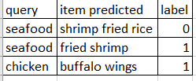
Visualizing the Data
Here we show three separate transactions
Each transaction consists of a query, item, and label
Query: what the user said they wanted
Item: the recommendation based upon the user’s query
Label: whether the user ended up liking the item that was recommended
The larger the data set the better our understanding of users tastes and preferences

Slide 6

MVP 1.0
Suppose we want to develop an MVP
An MVP consists of several releases. In every release the product gets better
First release: character match recommender system:
When a user says they are craving “X”, the system will select the item with the most similar text string to X
Thus, if a user says they are craving “fried chicken”:
The system may show them “chicken fried rice”
Why? Because “chicken” and “fried” are in both strings
Bottomline:
Obviously, chicken fried rice and fried chicken are very different dishes
Thus, users get “irrelevant” recommendations

Slide 7
MVP 2.0
Second release: Wide recommender system:
MVP produces irrelevant recs -> Apply ML to try to increase relevancy
We can learn an ML classifier from the dataset obtained from MVP 1.0
Input features: query, item (what we’re feeding into the ML model)
Output label: whether they consumed the product or not ( 1 or 0)
The ML model is “trained” to predict the probability of consumption given the query, item pair
The ML model is trained, and we investigate the features:
The feature AND(query="fried chicken", item="chicken and waffles") is a huge win
meaning whenever users get this rec, they end up consuming it
The feature AND(query="fried chicken", item="chicken fried rice") is a dud
meaning even though the character match is higher, users don’t consume it
Bottomline:
The ML model learns to memorize what users like and dislike
It learns to recommend items based upon probabilities, i.e., when users say they want fried chicken, they don’t want chicken fried rice, and won’t eat it if they get it
This increases the relevancy of our recommendations for our users

Slide 8
MVP 3.0
Third release: Deep Learning recommender system:
MVP 2.0 produces relevant but boring recs-> Apply DL to produce more interesting recs
We can learn a DL classifier from the dataset obtained from prior MVP versions
The DL model learns takes the query, item pairs and converts them into low dimensional dense representations (called embedding vectors)
These embedding vectors enables the DL model to generalize (deliver more interesting recs) by matching items to queries that are close in vectors space:
Now suppose “fried chicken” and “burgers” are close to each other in the embedding space
This means that “fried chicken” and “burgers” are similar
Thus, users presenting a query of “fried chicken” are probably ok with getting “burgers”
Bottomline:
The DL model improves upon MVP 2.0 by providing more interesting recs
Less work: the DL model performs automatic feature engineering on the raw data
The DL model learns the embedding vectors as part of the training process

Slide 9
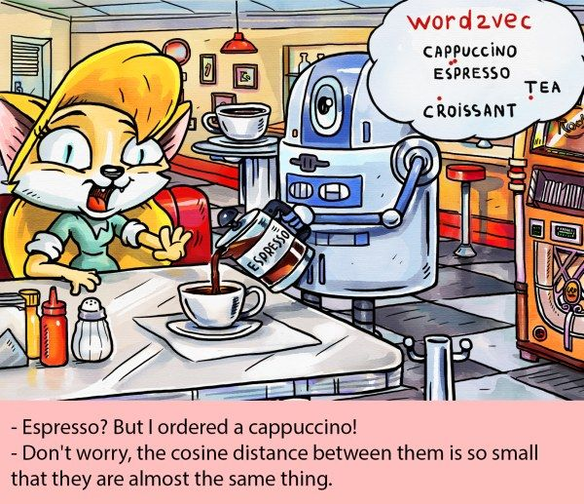
MVP 4.0

Slide 10
MVP 4.0
Fourth release: Wide & Deep Learning recommender system:
Problem: MVP 3.0 sometimes overgeneralizes (recommends irrelevant items)
We can learn a W&DL classifier from the dataset obtained from prior MVP versions
Sometimes, a user has a very specific query for which there is no substitute:
A user states that they want an “iced decaf latte with nonfat milk”
In this case, it is true that its vector is close to “hot latte with whole milk”
Hence the issue with making recommendations based upon distance metrics
The solution is to model these niche specific queries with a wide linear model
Here, “wide” refers to the sparse matrices that result from one-hot encoding categorical variables with high cardinality
Users making queries that are less specific like “seafood” or “italian food” may be more open to more generalization and discovering a diverse set of related items - > DL models excel here
The DL model and the Wide model are jointly trained which results in them “specializing”
Bottomline:
The W&DL model improves upon MVP 3.0 by better handling niche specific queries
The W&DL model combines the best of both worlds: DL with linear models

Slide 11
Technical Deep Dive

Slide 12
Background
Given an input query (a set of user and contextual information), we want to:
find a set of relevant items in a database
rank the items based on certain objectives, such as clicks or purchases
The goal is to strike a good balance between memorization and generalization:
Memorization: recommend things related to the things you've already clicked on
Generalization: recommend things you’ve never seen, i.e., novelty
Bottomline:
Too much memorization -> the recommendations you get are boring
Too much generalization -> the recommendations you get are irrelevant
A good RS produces recs that are interesting (relevant and not boring)

Slide 13
Motivation
Classification models such as Logistic Regression are often used to generate recs since they are easy to interpret
In this case, we are using probability of click as a measure of relevance:
Probabilities lower than some threshold, say 90%, are deemed “irrelevant”
Ranking is simply sorting the probabilities in descending order
Ranking can also be done on “clicks” and “purchases”
The input features into the classifier are often binary sparse features with one hot encoding:
"user_installed_app = netflix" has value 1 if user installed Netflix, 0 o/w

Slide 14
Motivation
Memorization can be achieved via sparse cross-product features such as :
AND(user_installed_app = netflix, impression_app = "pandora")
has value 1 if user installed Netflix and then is later shown Pandora, 0 o/w
Generalization can be achieved by using features that are less granular:
AND(user_installed_category = video, impression_app_category = "music")
has value 1 if user installed a video app and then is later shown a music app
This approach requires manual feature engineering

Slide 15
Motivation
Sparse cross-product features have one limitation:
cannot generalize to query-item feature pairs that have not appeared in the training data
Embedding-based models such as deep neural networks:
can generalize to previously unseen query-item feature pairs
They do so by learning a low-dimensional dense embedding vector for each query-item feature pair
This approach performs automatic feature engineering
However, it is difficult to learn low-dimensional representations when the underlying query-item matrix is sparse and high rank:
This occurs when users have very specific preferences
This occurs when we have niche items with very narrow appeal
This results in irrelevant recommendations due to over-generalization

Slide 16
Motivation
Linear models with cross-product feature transformations can memorize these exception rules with fewer parameters.
Thus, we can achieve both memorization and generalization in one model by jointly training a linear model component and a neural network component
Bottomline:
DNN’s improve upon Logistic Regression in their ability to perform automatic feature engineering on sparse binary features as well as their ability to generalize to previously unseen query-item feature pairs
However, DNN’s over generalize on sparse high rank matrices which occur when users have very niche preferences or items have small appeal
The solution is to model these edge cases with a linear model and then combine the two models to produce a final prediction

Slide 17
Results
Wide linear models can effectively memorize sparse feature interactions using cross-product feature transformations
Deep neural networks can generalize to previously unseen feature interactions through low dimensional embeddings
The Wide & Deep learning rec sys framework combines the strengths of both types of model
Google applied this method to Google Play, a large-scale app store:
Experiment results showed the Wide & Deep model led to a statistically significant increase in app installs over wide-only and deep-only models
https://ai.googleblog.com/2016/06/wide-deep-learning-better-together-with.html
https://arxiv.org/abs/1606.07792

